Slide 1
Hotel Revenue Project
Juan Pablo Fernandez

Slide 2
Agenda
Is the total hotel revenue growing by year?
Which is the most profitable market segment?
Which type of guests are staying in the hotel?

Slide 3
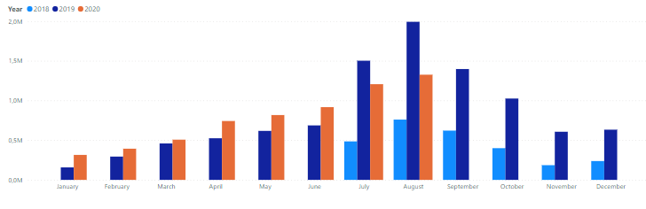
1. Is the revenue growing by year?
Given that there is no complete data for 2018 and 2020 the best that can be done is compare the months for which there is data.
Per the above graph:
Comparing 2020 to 2019, revenue increased in all months except July and August.
Comparing 2019 to 2018 revenue grew significantly across all months.
Conclusion: Based on the previous análisis, it’s reasonable to conclude the revenue has been growing year over year.

Slide 4
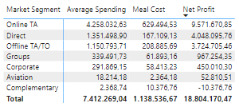
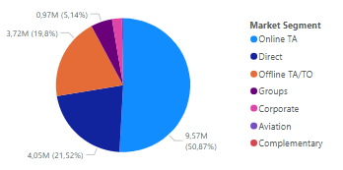
2. Which is the most profitable market segment?
Online TA is the most profitable segment and represents 50.67% of the total revenue.
Direct and Offline TA/TO are the 2nd and 3rd segments with roughly 20% of total revenue.
Complementary segment does not generate revenue, moreover it generates loses.
Conclusion: The hotel should focus on Online TA, Direct and Offline TA/TO segments which generates 90% of total revenue.
It should be evaluated if hotel should keep Aviation and Complementary segemnts since they don’t generate much revenue.

Slide 5
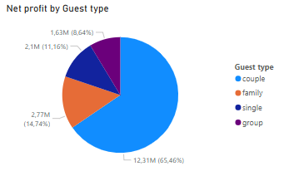
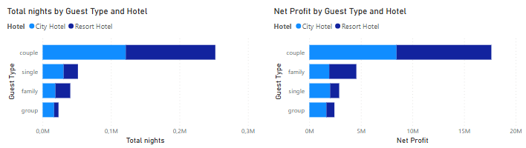
3. Which type of guests are staying in the hotel?
Couples are the most relevant guest type generating 65% of the total revenue and spending more nights than the others.
Singles spend more nights than families, however families generate more revenue. Therefore, families are more profitable to the hotel than singles.
Conclusion: Considering the absence of data indicating higher costs for multi-person groups (families, couples and groups), we recommend that the hotel prioritize the 'couples' and 'families' segments based on our current data.

